Slide 1

Apple M1 born to be first

Slide 2
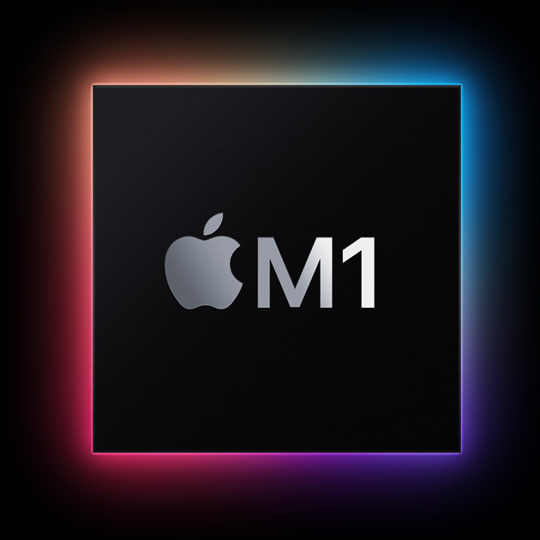
Today we will talk:
1) Features
2) Structure of Apple M1
3)Comparison

Slide 3
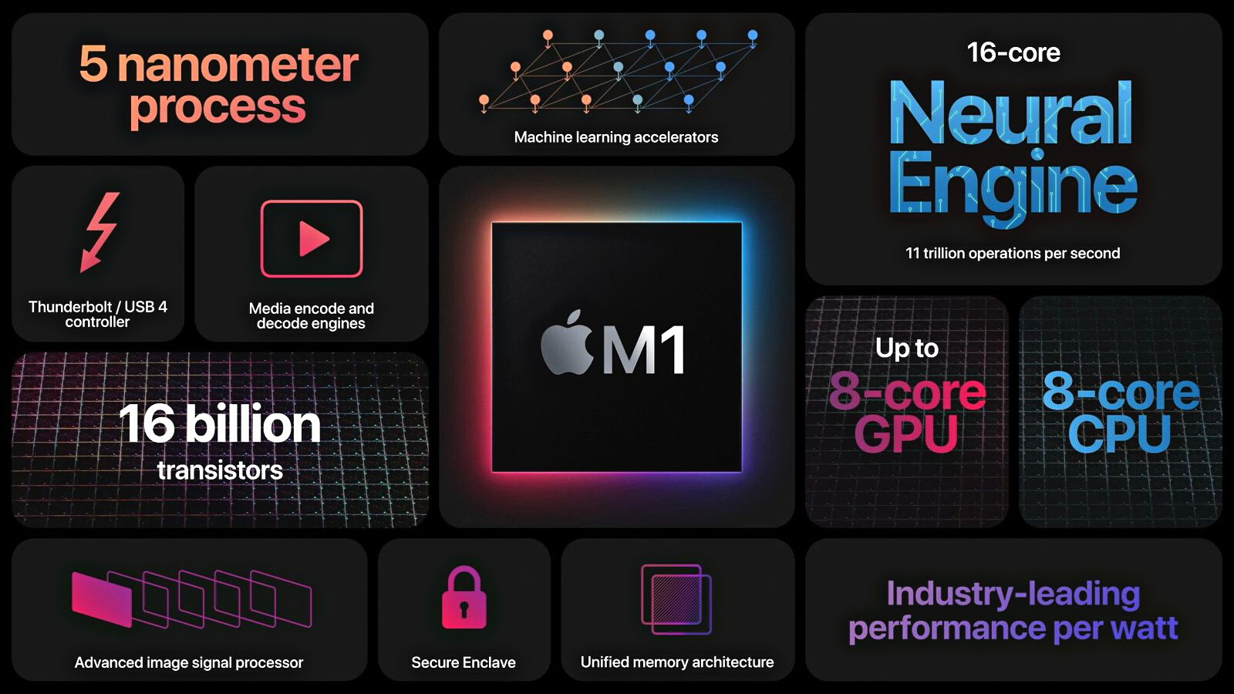
Here is representation of some pieces of information made by Apple company

Slide 4

Neural Engine
The M1 chip has a built-in Neural Engine, a component that Apple first started adding to its A-series chips a few years ago. The Neural Engine is designed to accelerate machine learning tasks across the Mac for things like video analysis, voice recognition, image processing, and more.
The 16-core Neural Engine is capable of 11 trillion operations per second for up to 15x faster machine learning performance compared to the previous generation of models that have moved to the M1.
Apple M1 Speed
The M1 chip brings up to 3.5x faster CPU performance, up to 6x faster GPU performance, and up to 15x faster machine learning capabilities compared to the Intel chips used in prior-generation machines.
Compared to the latest PC laptop chips, the M1 offers 2x faster CPU performance and does so using just 25 percent of the power.

Slide 5
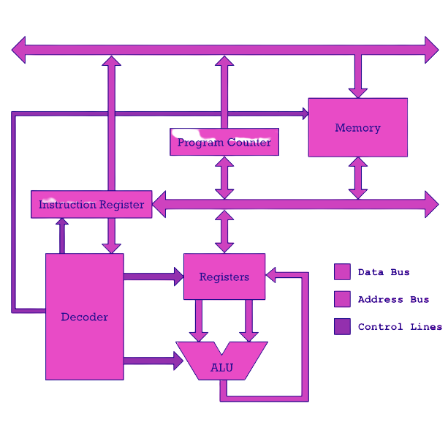
What is a microprocessor CPU?
Usually, when we talk about chips from Intel or AMD, we mean CPU. As I wrote in my article "RISC vs CISC", the CPU loads instructions from memory and then each instruction is executed sequentially.The CPU at the most basic level is a device with a few named memory cells called registers and some number of computing units called arithmetic and logic units called ALUs. The ALU performs addition, subtraction, and other simple mathematical operations. Meanwhile, these units are only connected to the registers of the CPU. If you want to add two numbers, you must first get them from memory and then put them in registers.

Slide 6
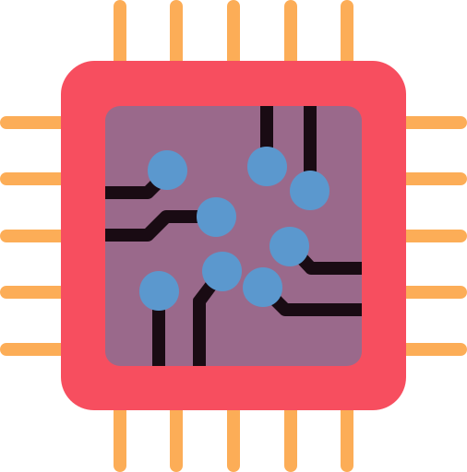
Here are a few examples of typical instructions that both the RISC processor and the M1 Include perform:
Here r1 and r2 are the registers I mentioned earlier. Modern RISC processors are not capable of performing operations on numbers that are not in registers. Even if the numbers are in RAM, they are still inaccessible to the CPU. They must first be placed in the two corresponding registers. In the example above, we first store the number from cell 150 in RAM in register r1, then do the same for the number from cell 200 and store it in register r2. Only then can the numbers be added by the add instruction.
The concept of registers is old. For example, on this old calculator, the register is the mechanism that holds the number used in the operation. Just like a real cash register. The register is the "location" where you register the incoming number.
load r1, 150
load r2, 200
add r1, r2
store r1, 310

Slide 7
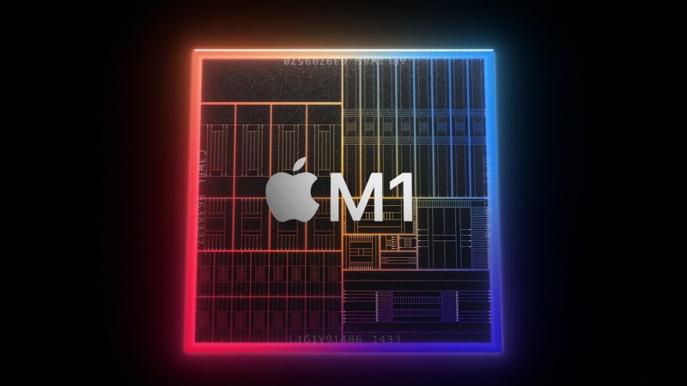
M1 is not a CPU
A very important thing to remember: the M1 is not just a CPU. It is a system of many chips in one silicon wrapper. The CPU, on the other hand, is one of those chips. Technically, the M1 is the entire computer on one chip. It contains the CPU, GPU, memory, I/O controllers, and many other things that make a computer a computer. This is what we call a system on the chip (SoC).
Today, if you buy a chip, Intel or AMD, you're actually buying a large number of microprocessors in one wrapper. In the past, computers had several physically separate chips on the motherboard.Today we have the ability to put many transistors on one chip, so both Intel and AMD have started making chips with many microprocessors. We call them "cores" of a processor. A single core is essentially a completely independent chip that can read instructions and execute them. A microchip with multiple CPUs.For a long time, this was the essence of the power upgrade game: just add more cores to the CPU. But someone rebelled in the ranks of manufacturers: one player in the chip market went his own way.

